Slide 1


Hii,
Iam Siddhika
Welcome to Power BI Series
Part -65

Slide 2



I’m very excited to dive into this with you all!
Are you ready to enhance your data visualization skills?
We focus only on the most used and important Visuals
Today Content
VISUALIZING DATA
VISUALS - PART -TO - WHOLE
PIE CHART DOUGHNUT CHART

Slide 3
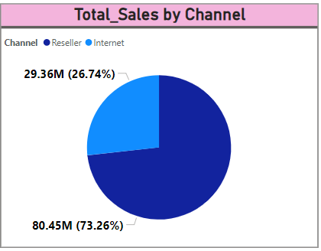


PIE CHART
Go and
A pie chart is a circular chart divided into sectors, each representing a proportion of the whole. Each sector's arc length, and consequently its central angle and area, is proportional to the quantity it represents.
explore
formatting
of Pie
CHART
When to Use:When you want to show proportions or percentages of a whole.
To display parts-to-whole relationships. When the number of categories is relatively small.
Purpose: To provide a quick and easy way to visualize the composition of a dataset.
To compare different parts of a whole in a visually appealing way.

Slide 4
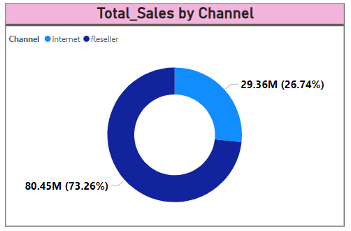


DOUGHNUT CHART
Go and explore formatting of Doughnut Chart
A doughnut chart is similar to a pie chart but with a
blank center, allowing for more data to be represented visually. It provides a slightly different look and can accommodate additional labels or data points in the center.
When to Use:Similar to pie charts, when you want to show proportions or percentages of a whole.
When you need to add more context or additional data points in the center of the chart. When you want to present data in a visually appealing and slightly different format compared to a pie chart.

Slide 5


Thank you for joining me today to learn about Part -65 of Power BI!
Remember, Effective data visualization is crucial for turning data into meaningful insights and compelling narratives with Power BI.
Stay tuned for more insights and tips on Power BI in our next Series.
Follow
Siddhika Shah

